Slide 1
Week-8: Gladiators
Team Members: Shivani Asokumar, Akash Narang, Mit Jain, Juhi Malkani
Team Lead: Mit Jain

Slide 2

Project: E-commerce Website for Footwear

Slide 3
Team Progress Update
Static Seller page
Integration of APIs into seller page (In progress)
Product Listing API integration
Shopping Cart feature
Frontend
Backend APIs have been setup
Product Listing API (completed)
Seller Page APIs (completed)
Individual Product Page, Wishlist, Shopping Cart APIs (In progress)
Backend

Slide 4
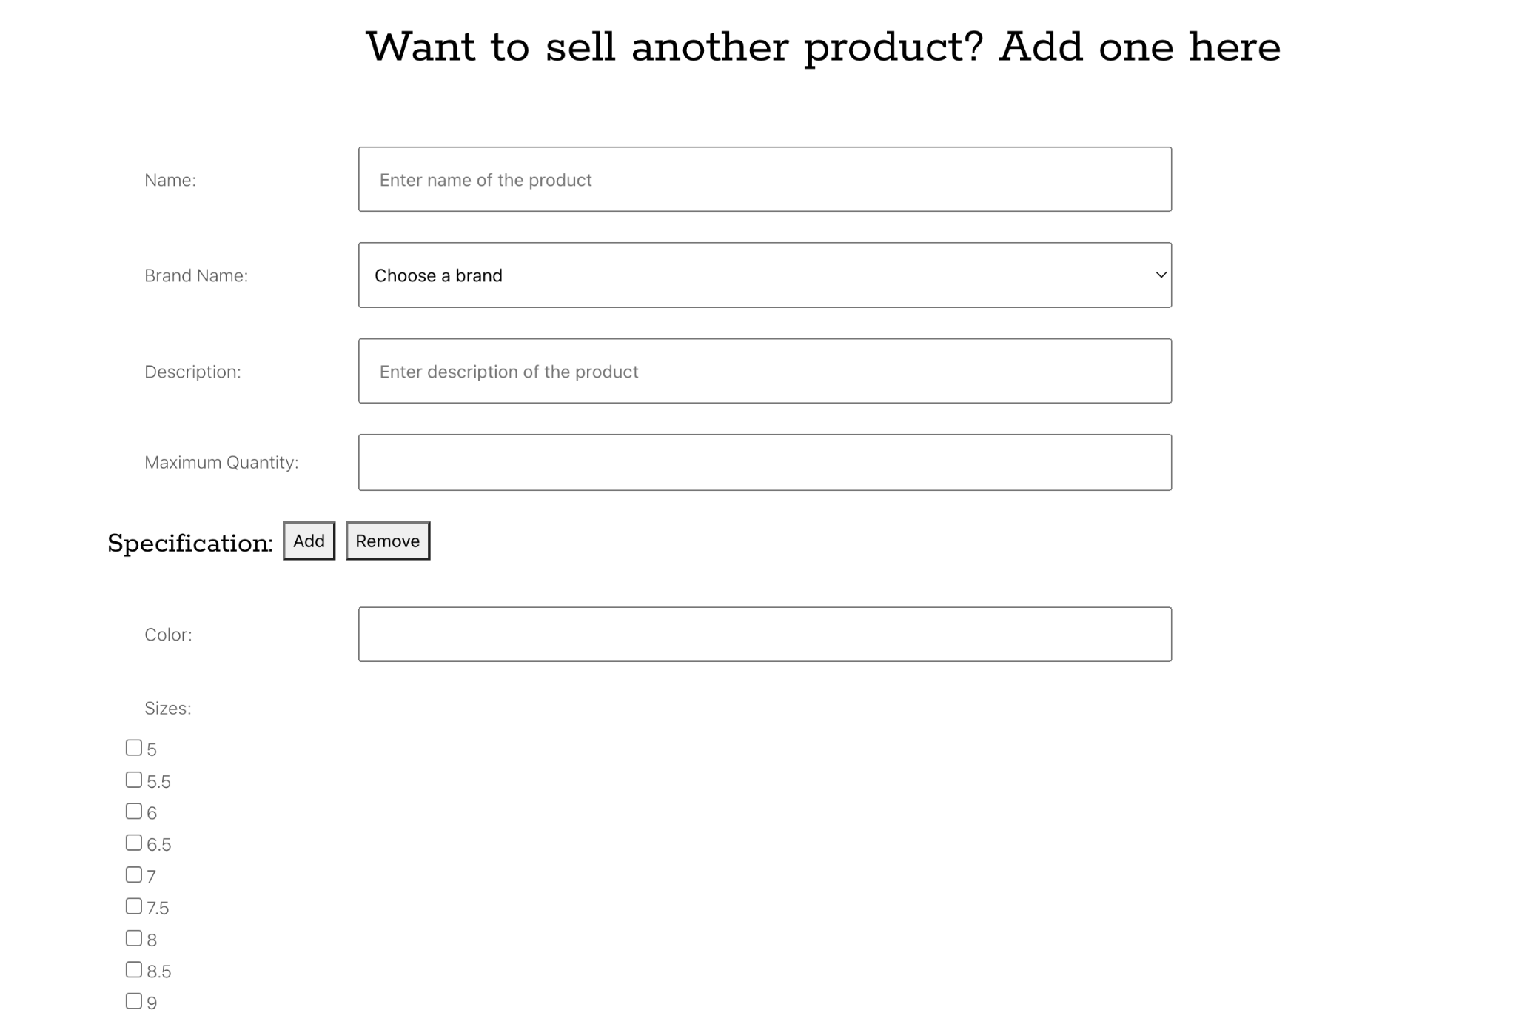
Static Seller Page (Completed)

Slide 5
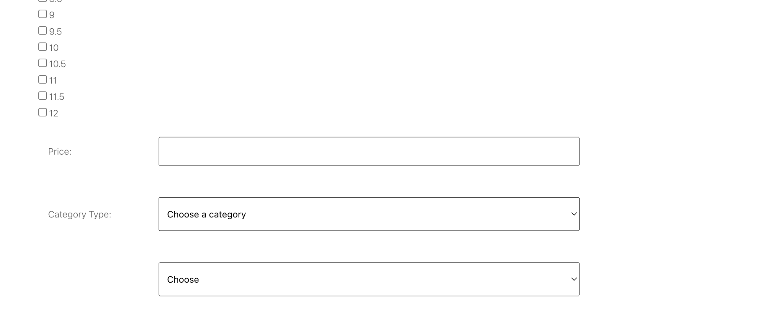
Static Seller Page (Completed)

Slide 6
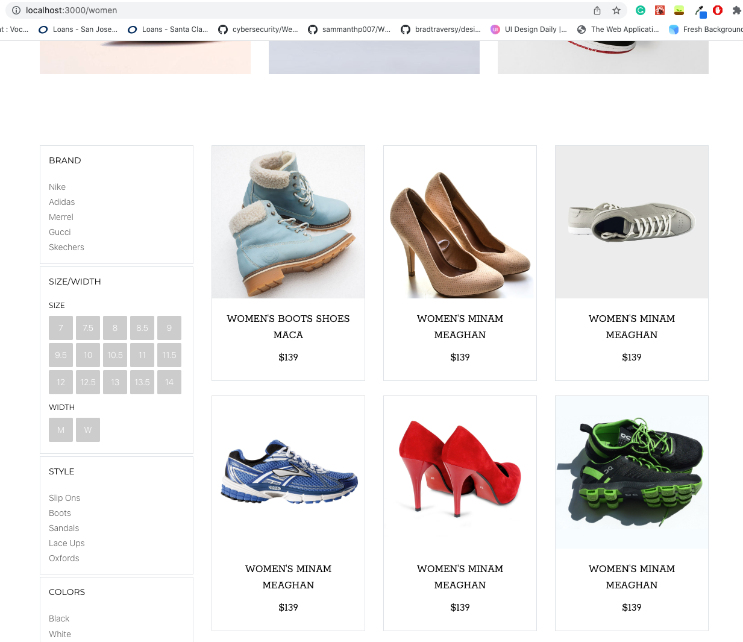
Product Listing

Slide 7
Test Plan
Cart: Should display # products in cart and info
Men/Women’s: Should filter items based on gender
Best Sellers: Should be displayed on home page with trending products
Checkout/Payment: Users should be able to complete their purchase
Order Summary: Should display order number and details

Slide 8
Test Plan
Seller page: should allow the seller to add items to the inventory, should display a form
User Authentication: Should allow users to login or create an account. Authenticates the users

Slide 9
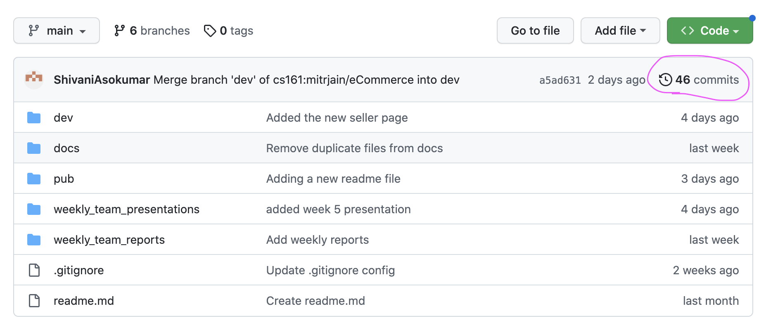
Check project status
Github: https://github.com/mitrjain/eCommerce

Slide 10
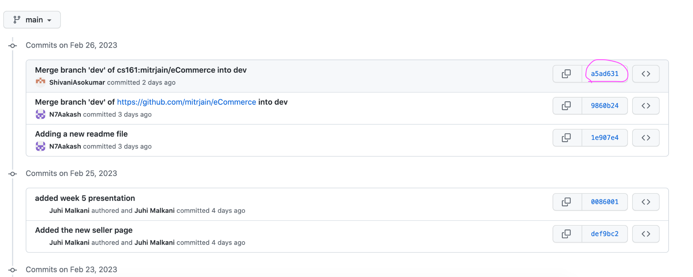
Check project status (cont)

Slide 11
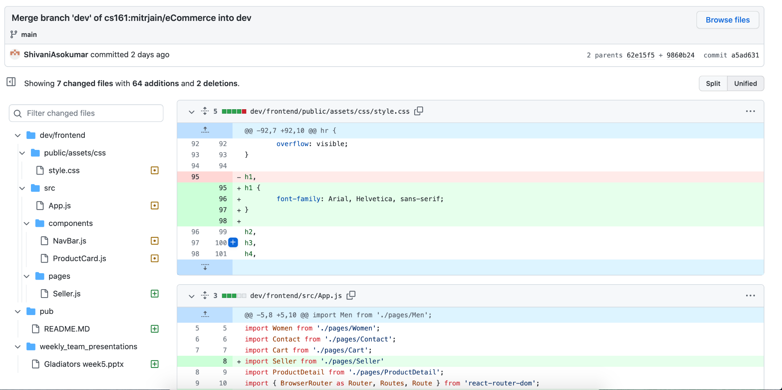
Check project status (cont)

Slide 12
Milestones
M1
Seller Page
M2
Shopping Cart
M3
Men/Women
Best Sellers
M4
User Auth
Order Summary
M5
Checkout/Payment

Slide 13
Two Seniors Feedback:
Documentation is clean and easy to read
Unclear how to setup backend with postman and changing .env file name
App not able to run

Slide 14
(Team) Feedback Response:
We will change the docs to make the backend setup more seamless
The app wasn’t running because the CORS extension needed to be used

Slide 15
Thanks!

